Slide 1
Works
1
Experiment repeatability (tumor detection model)
2
OncoKB (An FDA-Recognized Human Genetic Variant Database)

Slide 2
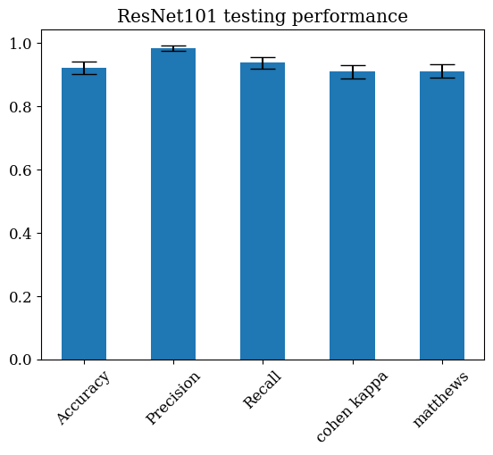
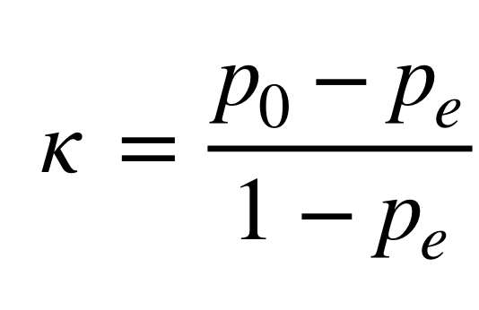

ResNet101 (tumor detection model)
testing | accuracy | precision | recall | cohen kappa | matthews
result | 0.923 ± 0.019 | 0.984 ± 0.009 | 0.938 ± 0.018 | 0.91 ± 0.021 | 0.911 ± 0.021

Slide 3
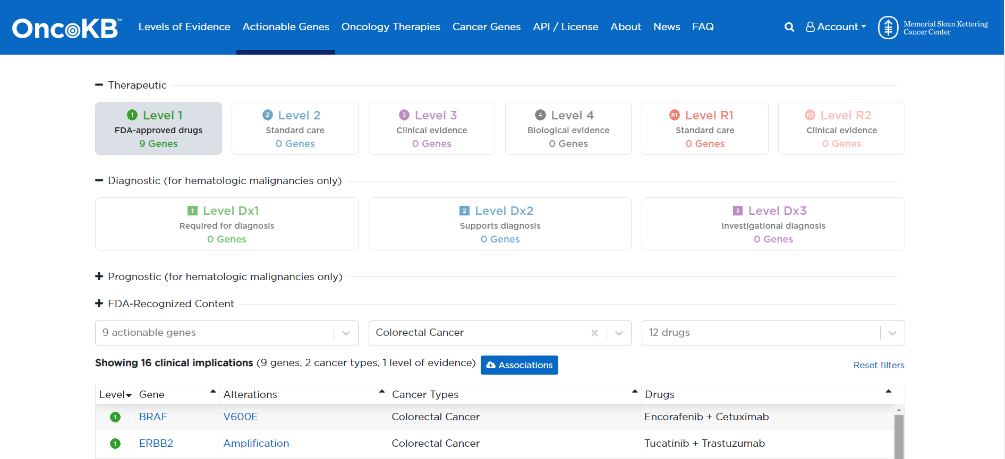
OncoKB

Slide 4
Future works
1
Keep producing additional research final result

